Slide 1
Tech Associate Programme
DSAID Assessment
By Daniel Fung​

Slide 2
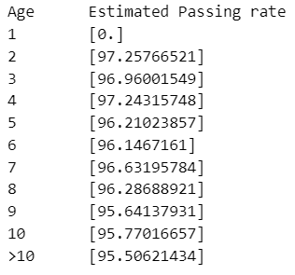
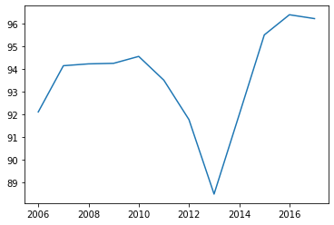
Question 1
Task 1: 93.3%
Task 2:
From age group 1, I see that there are no new motorcycles after 2013 being added
As the number of inspected motorcycles from age group 2 onwards depend on age group 1, the trend after year 2013 will be different.
From the plots, I notice that the passing rate is stable for age group 2 onwards after 2013. Thus, I estimate each age group to maintain their passing rate from 2016 ->
Task 3:
Looking at the line plot below, we ignore data from 2013 & 2014 as they are anomalous
95% confidence interval: (93.2, 95.4)

Slide 3
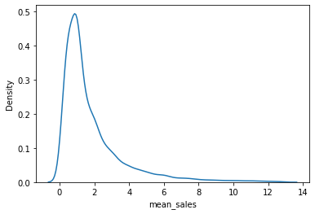
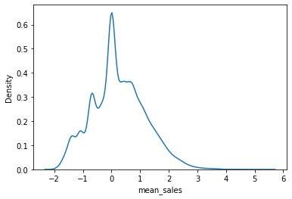
Question 2
Task 1:
Get total sales per salesperson and divide by number of years of experience each salesperson has. Ans: 2.08 years with standard deviation 3.39
Task 2:
Power law distribution can be used
Plotting mean houses sold per year shows a right-tailed graph (right, top) but plotting the log of the mean houses sold per year gives a symmetrical graph (right, bottom)
Limitations: It assumes that the number of sales is governed by an exponential function
Task 3:
I

Slide 4
Question 3
Task 1:
There is wide coverage of hotspots
There is some invalid data entries in Y and X to ignore
You can add features like HDB (using postal codes) and MRT (from the name)
Task 2:
Used random forest classifier for the multiclass classification to handle the non-linearity of the features
Task 3:
Overall model accuracy: 57%
Micro-F1 score is same as accuracy at 0.57. This one is important as there is imbalance in the data, and it can capture the classification performance of all the classes

Slide 5
Question 4
The percentage of group Y graduates who do not work in a closely related field is even higher at 35%. Although salary is also a factor, they have other reasons for moving industries
27% of graduates from group X choose not to work in a closely related field to their studies because of higher salaries
Even for those who work in industries related to their course, group X graduates tend to get higher salaries of up to $4100, compared to $3900 for those in group Y

Slide 6
Question 4
Closely related to course of study
Proportionately more from group X work in industry B
Somewhat related to course of study
Proportionately less from group Y choose to work in industries F & E

